Slide 1
Branch Sums
Binary Tree (23.07.10)

Slide 2
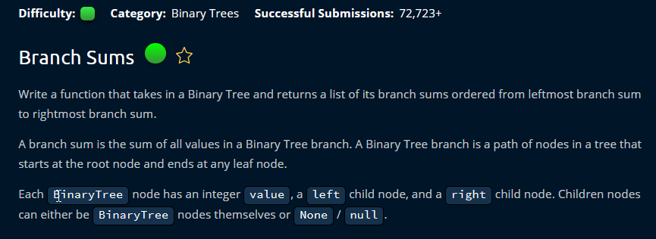

Slide 3
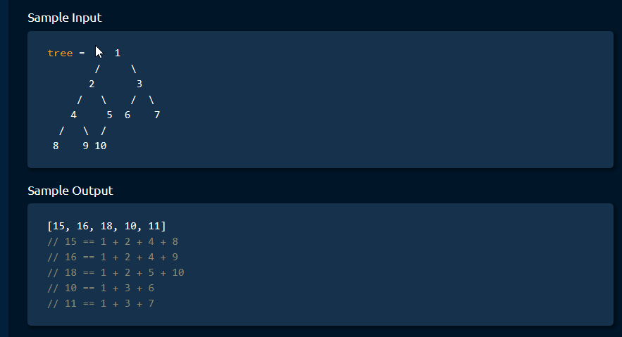

Slide 4


Slide 5


Slide 6
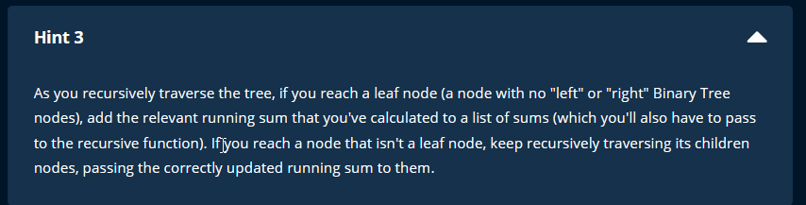

Slide 7


Slide 8
